Slide 1
Lecture 5 Dr. Suha K. Shihab
OTHER EXPENDABLE-MOLD CASTING PROCESSES
INVESTMENT CASTING
A pattern made of wax is coated with a refractory material to make the mold, after which the wax is melted away prior to pouring the molten metal. It is also known as the lost-wax process, because the wax pattern is lost from the mold prior to casting.
Steps in investment casting are described in Figure1
(1) wax patterns are produced;
(2) several patterns are attached to a sprue to form a pattern tree;
(3) the pattern tree is coated with a thin layer of refractory material;
(4) the full mold is formed by covering the coated tree with sufficient refractory material to make it rigid;
(5) the mold is held in an inverted position and heated to melt the wax and permit it to drip out of the cavity;
(6) the mold is preheated to a high temperature, which ensures that all contaminants are eliminated from the mold; it also permits the liquid metal to flow more easily into the detailed cavity; the molten metal is poured; it solidifies;
(7) the mold is broken away from the finished casting. Parts are separated from the sprue.

Slide 2
Lecture 5 Dr. Suha K. Shihab
General Design Considerations
Since the wax pattern is melted off after the refractory mold is made, a separate pattern must be made for every casting.
Pattern production is usually accomplished by a molding operation—pouring or injecting the hot wax into a master die that has been designed with proper allowances for shrinkage of both wax and subsequent metal casting.
In cases where the part geometry is complicated, several separate wax pieces must be joined to make the pattern.
In high production operations, several patterns are attached to a sprue, also made of wax, to form a pattern tree; this is the geometry that will be cast out of metal.
Coating with refractory (step 3) is usually accomplished by dipping the pattern tree into a slurry of very fine grained silica or other refractory (almost in powder form) mixed with plaster to bond the mold into shape.
The small grain size of the refractory material provides a smooth surface and captures the intricate details of the wax pattern.
The final mold (step 4) is accomplished by repeatedly dipping the tree into the refractory slurry or by gently packing the refractory around the tree in a container.
The mold is allowed to air dry for about 8 hours to harden the binder.

Slide 3
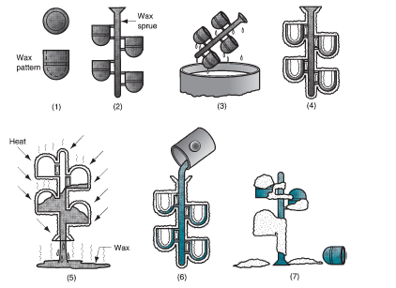
Lecture 5 Dr. Suha K. Shihab
FIGURE 1 Steps in investment casting

Slide 4
Lecture 5 Dr. Suha K. Shihab
Advantages of investment casting :
Parts of great complexity and small in size can be casted.
2. Close dimensional control can be achieved.
3. Good surface finish is possible;.
4. Wax can usually be reused.
5. Additional machining is not normally required.
Disadvantages of investment casting :
The process is expensive
Require many operations to make a mold
Require very long production –cycle times.
Examples of parts include complex machinery parts, blades, and other components for turbine engines, jewelry, and dental fixtures.
All types of metals, including steels, stainless steels, and other high temperature alloys, can be investment cast.

Slide 5
Lecture 5 Dr. Suha K. Shihab
SHELL MOLDING
is a casting process in which the mold is a thin shell (typically 9mm) made of sand held together by a thermosetting resin binder. the process is described and illustrated in Figure 2.
Steps in shell molding are described in Figure 2:
a match-plate or cope-and-drag metal pattern is heated and placed over a box containing sand mixed with thermosetting resin.
box is inverted so that sand and resin fall onto the hot pattern, causing a layer of the mixture to partially cure on the surface to form a hard shell.
box is repositioned so that loose, uncured particles drop away.
sand shell is heated in oven for several minutes to complete curing.
shell mold is stripped from the pattern.
two halves of the shell mold are assembled, supported by sand or metal shot in a box, and pouring is accomplished.
The finished casting with sprue are removed .

Slide 6
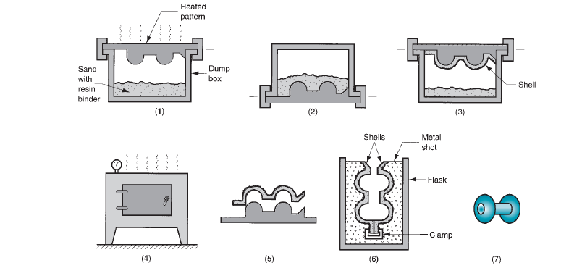
Lecture 5 Dr. Suha K. Shihab
FIGURE 2 Steps in shell molding

Slide 7
Lecture 5 Dr. Suha K. Shihab
Advantages To The Shell Molding Process:
The surface of the shell mold cavity is smoother than a conventional green-sand mold, and this smoothness permits easier flow of molten metal during pouring and better surface finish on the final casting.
Good dimensional accuracy is also achieved with tolerances of 0.25 mm possible on small-to-medium-sized parts.
Machining operations are reduced because of good surface finish
Collapsibility of the mold is generally sufficient to avoid tearing and cracking of the casting.
can be mechanized for mass production and will be economical too.
Disadvantages Of Shell Molding
expensive metal pattern is required, and hence not suitable for small quantities.
Examples of parts made using shell molding include gears, valve bodies, bushings, and camshafts.

